Slide 1

WELCOME ☺
To the Bellevue School District and
Special Needs PTA Parent Workshop –
Understanding Special Education

Slide 2


Credit to -

Slide 3

Parent Wish
What is your wish for your child?
Please take a few minutes and write down a dream or wish you have for your child.
Notes:
K

Slide 4

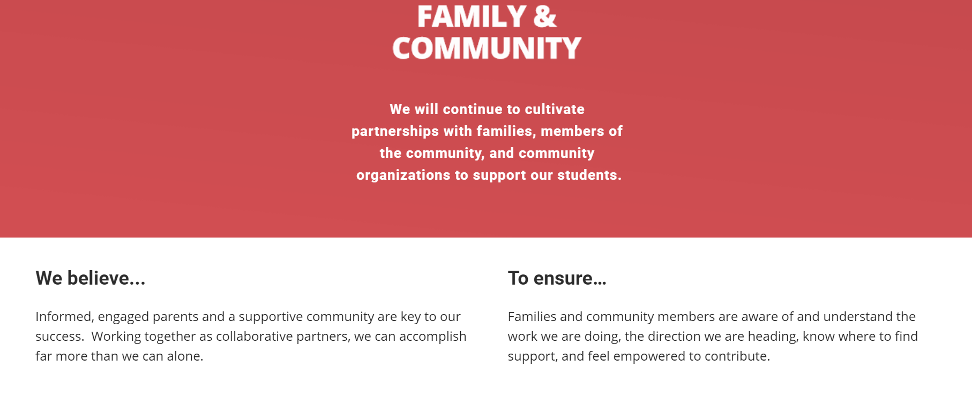

Slide 5
INDIVIDUALS WITH DISABILITIES EDUCATION ACT (IDEA)
The purpose of this law is “…to ensure that all children with disabilities have available to them a free appropriate public education… designed to meet their unique needs and prepare them for further education, employment, and independent living.”

Slide 6

Special Education
On a post-it write something you’d like to learn about Special Education.

Slide 7
PRE-REFERRAL in a school
If a child is not progressing within the general education setting –
Additional supports will be provided
Data collected and progress reviewed
If there is not enough positive response a referral may be made to the school evaluation team

Slide 8
PARENTS’ CONSENT
  Informed Consent means the parent:
    Is fully informed in his or her native language or other mode of communication,
    understands and agrees in writing to the evaluation, or initiation of services,
    understands that the granting of consent is voluntary and may be revoked at any time.
Parents must give informed written consent before a child may be evaluated and before the initial IEP is implemented.

Slide 9
How is a decision made about my child's eligibility for special education?
Disability (defined in IDEA law)
Adverse Educational Impact
Eligible for an IEP
Needs Specially Designed Instruction
Notes:
If a student meets the 3 parts of eligibility under the IDEA then
A team, including parents, will create an Individualized Education Plan
If student does not meet all 3 parts of eligibility under IDEA, might be eligible for a Section 504 Plan
The IDEA has specific definitions for each disability category that is covered by the law. Sometimes those differ from definitions that doctors might use.
“special education” = “specially designed instruction” The need for special education is a key part of eligibility – if a student needs “only accommodations or related services” then the student may be covered by Section 504 but not eligible for an IEP
• Autism • Deaf-Blindness • Deafness • Developmental Delay (DD) for ages 3-8 • Emotional/behavioral disability (EBD) • Hearing impairment (HI) • Intellectual Disability • Multiple Disabilities • Orthopedic Impairment (OI) • Other Health Impairment (OHI) • Specific Learning Disability (SLD) • Speech/Language Impairment • Traumatic Brain Injury (TBI) • Visual Impairment (VI)

Slide 10
Timeline
All information relative to the presence of a disability is used to determine your student’s educational needs.
25
school days to decide
35
school days to evaluate
30
calendar days to write IEP

Slide 11

So my child has been found eligible for special education. What next?
30 calendar days
You will be contacted to schedule a meeting

Slide 12
Individualized Education Program (IEP)
The Individualized Education Program is a written document called an IEP
Created by the IEP team
Reviewed by the IEP team at least once a year
It is a “working document” that can be changed at any time by the IEP team to meet the child’s needs
A parent’s written consent is required before the initial IEP may be implemented

Slide 13
THE IEP TEAM
IEP Team
Student
Parent
Others with knowledge or expertise
Administrator
General Educator
Special Educator

Slide 14
PARENT PARTICIPATION
For parents:
Advance notification of the meeting;
Schedule the meetings at a time and place that works for parents and the school;
Informing parents of the purpose of the meetings, and who will attend;
Informing parents that they may invite others with knowledge or special expertise to attend;
And an interpreter if needed

Slide 15

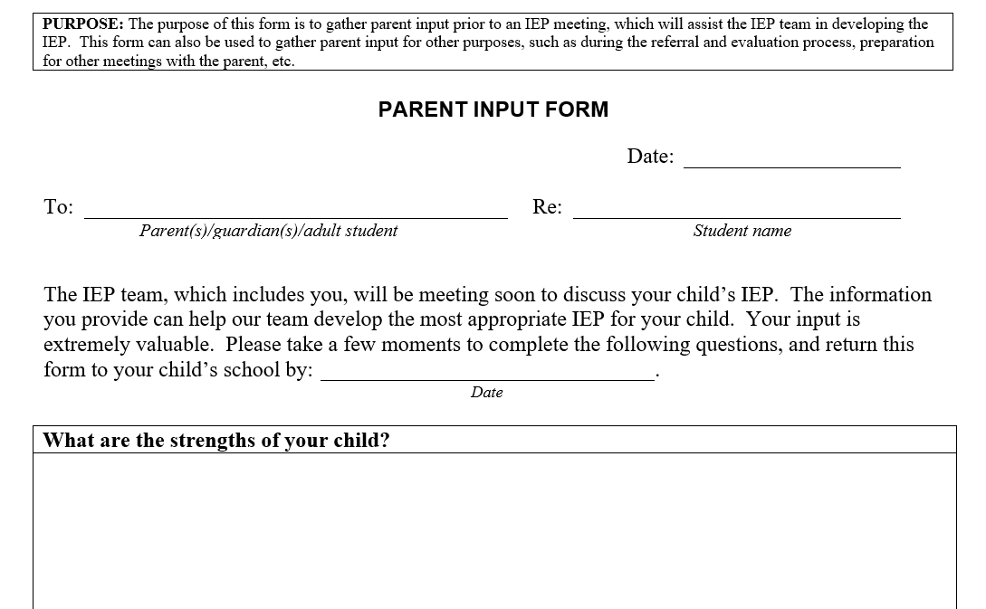
What should I do before the IEP meeting?

Slide 16

A parent’s role at the IEP meeting is to:
learn and understand the process
share information
ask questions
offer suggestions
keep the team’s focus on your child’s long-term needs and
speak up on your child’s behalf

Slide 17

What happens during an IEP meeting?
At the IEP meeting the team will develop, review, and/or revise the IEP document

Slide 18
PARTS OF THE IEP:
TEAM CONSIDERATIONS
Student’s Strengths, Parent Concerns
Results on state or district wide assessments
Communication needs
Assistive Technology devices and services needs
Behavioral interventions if behavior impedes learning
Language needs for limited English proficient students
Braille Instruction for students who are blind or visually impaired

Slide 19

PRESENT LEVELS OF PERFORMANCE & MEASURABLE ANNUAL GOALS
Present levels: describe the student’s current abilities and challenges in each academic and functional area effected by disability;
Where are we now?
Where do we want to be in a year?
Measurable Goals: identify particular skills that will be targeted with specially designed instruction to enable the student to be involved in and make progress in the general education curriculum

Slide 20
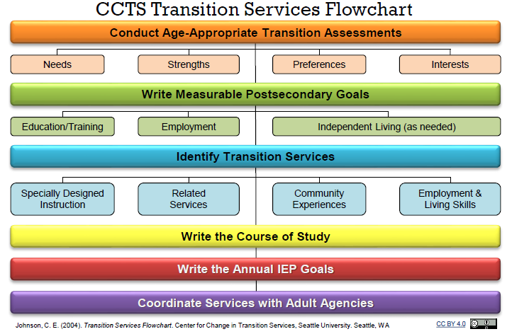
TRANSITION PLAN
Education
College?
Employment
Career?
Technical School?
Other?
Jobs?
Independent Living
Travel
Self Care (health, housing, other)
Finances
15

Slide 21
ACCOMMODATIONS/MODIFICATIONS
May include:
How information is presented or knowledge is shown;
Timing/scheduling for instruction or assessments;
Changes to physical settings;
Necessary supports for the student and/or school staff

Slide 22


Slide 23
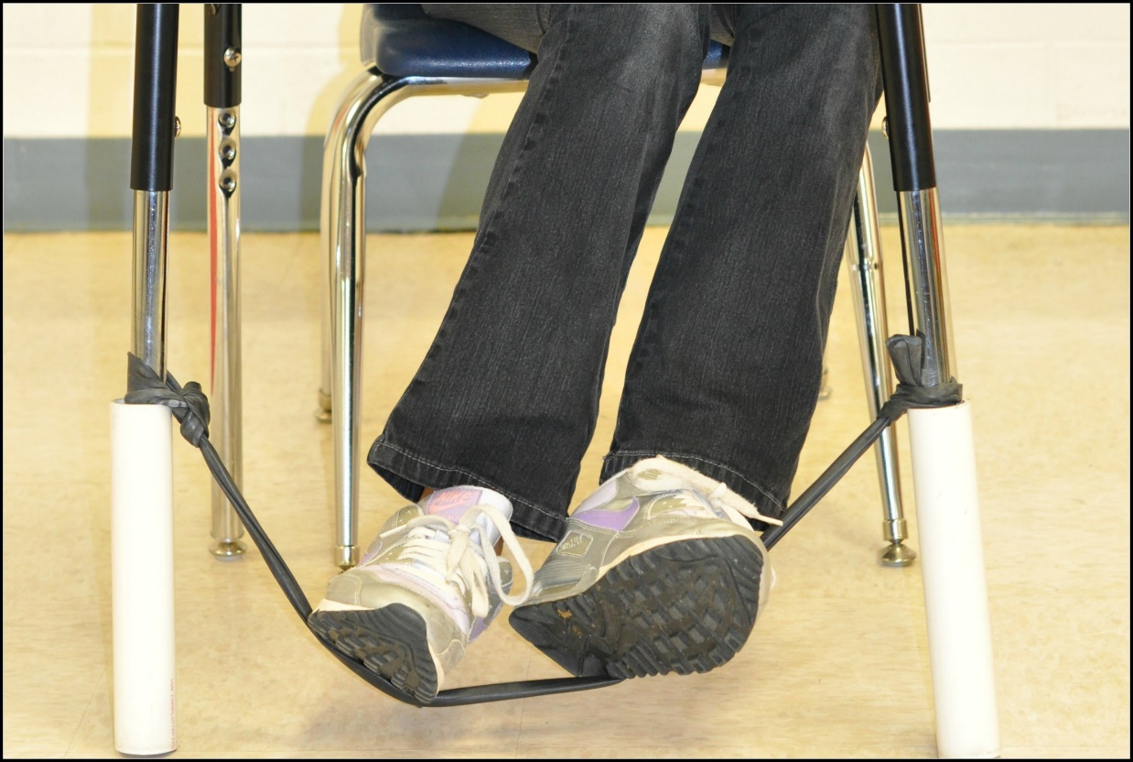

Slide 24
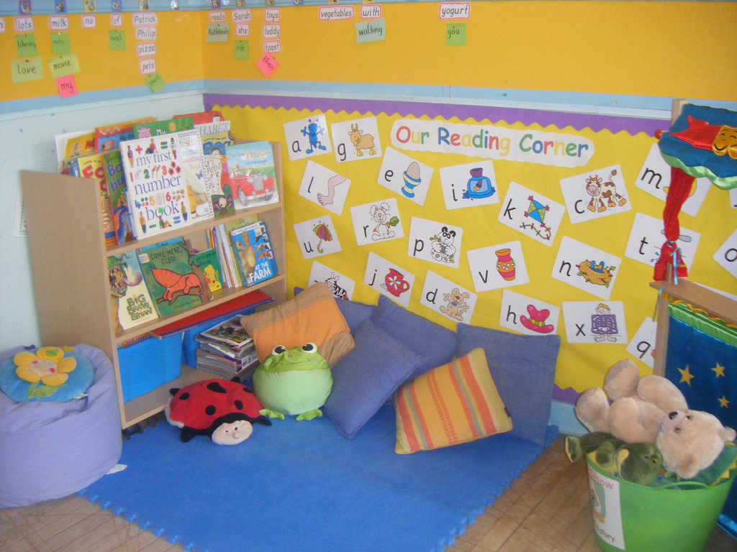

Slide 25
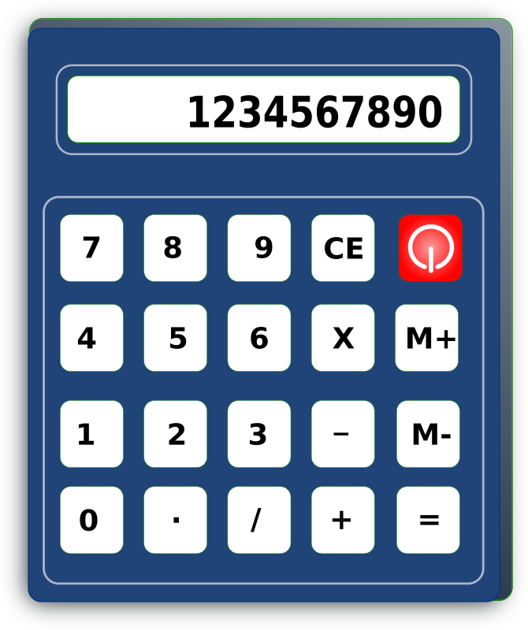


Slide 26


Slide 27


Slide 28
SPECIAL EDUCATION SERVICES MATRIX: DEFINES AREAS OF Specially Designed Instruction AND RELATED SERVICES
Who will provide it;
Who will supervise it;
Where it will be provided;
For how many minutes; and
How frequently.
Example
Concurrent | Service | Service Provider | Monitor | Frequency | Location | Start Date | End Date
No | Math | Special education teacher | Special Education Teacher | 50 min/5 times weekly | Special education | 11/1/19 | 10/31/20
No | Reading | Special education teacher | Special education teacher | 30 min/5 times weekly | Special education | 11/1/19 | 10/31/20
No | Social skills | Special education teacher | Special education teacher | 10 min/4 times weekly | General education | 11/1/19 | 10/31/20

Slide 29
PLACEMENT:
LEAST RESTRICTIVE ENVIRONMENT
Describes the extent to which the student will be educated with children who are not disabled and
Identifies the type of setting where the student will receive special education services.

Slide 30
OTHER CONSIDERATIONS FOR IEP
ESY – Extended School Year
Transportation
Physical education

Slide 31
After the meeting –
The Prior Written Notice (PWN)
(What) Action being proposed or refused
(Why) reasons proposed or refused
(How) Evaluations, records, etc. relied on in reaching the decision
Description of other options considered and why they were rejected, and
Information about parents’ procedural safeguards
“Prior” = After a decision is made, before it is implemented.

Slide 32

AGE OF MAJORITY
Beginning not later than one year before the student reaches the age of eighteen, the IEP must include a statement that the student has been informed of the student's rights under the act, if any, that will transfer to the student on reaching the age
of majority.
WAC 392-172A-03090

Slide 33

Can my child's IEP be changed?
A PARENT or other team member might ask for a meeting to discuss:
    Concerns about a student’s progress or behavior;
    New information about the student’s needs, abilities or challenges;
    Possible adjustments to a plan for increased inclusion

Slide 34
How Do IEP Teams Work?
IEP Teams should practice shared decision making and work to build consensus
If there is not agreement: it is the District’s responsibility to provide the Free Appropriate Public Education to the child, so the district must make a decision and inform the parent in writing of the decision and reasons for it.

Slide 35

Your Rights

Slide 36
If we try and we still don’t agree…
Ask the IEP team to reconsider or postpone a change until it has more information or further discussion
Work out a plan with the IEP team to take data so the team can review in a reasonable period of time to see effects
Seek help in resolving the disagreement (e.g., advocate, liaison, ombuds)

Slide 37

Who can help me during this process?
Office of the Education Ombuds (OEO)
1-866-297-2597 www.oeo.wa.gov
OSPI’s Special Education Parent Liaison
360-725-6075
  http://www.k12.wa.us/SpecialEd/Families/Assistance.aspx
Open Doors for Multicultural Families
253-216-4479
https://www.multiculturalfamilies.org/
Partnerships for Action Voices for Empowerment (PAVE)
(800) 5-PARENT (v/tty)
https://wapave.org/
Arc of King County https://arcofkingcounty.org/
Bellevue Special Needs PTSA https://www.bellevuespecialneedspta.com/

Slide 38

Our goal is to –
Cultivate partnerships with families
Informed, engaged parents and a supportive community are key to our success. Working together as collaborative partners, we can accomplish far more than we can alone.

Slide 39
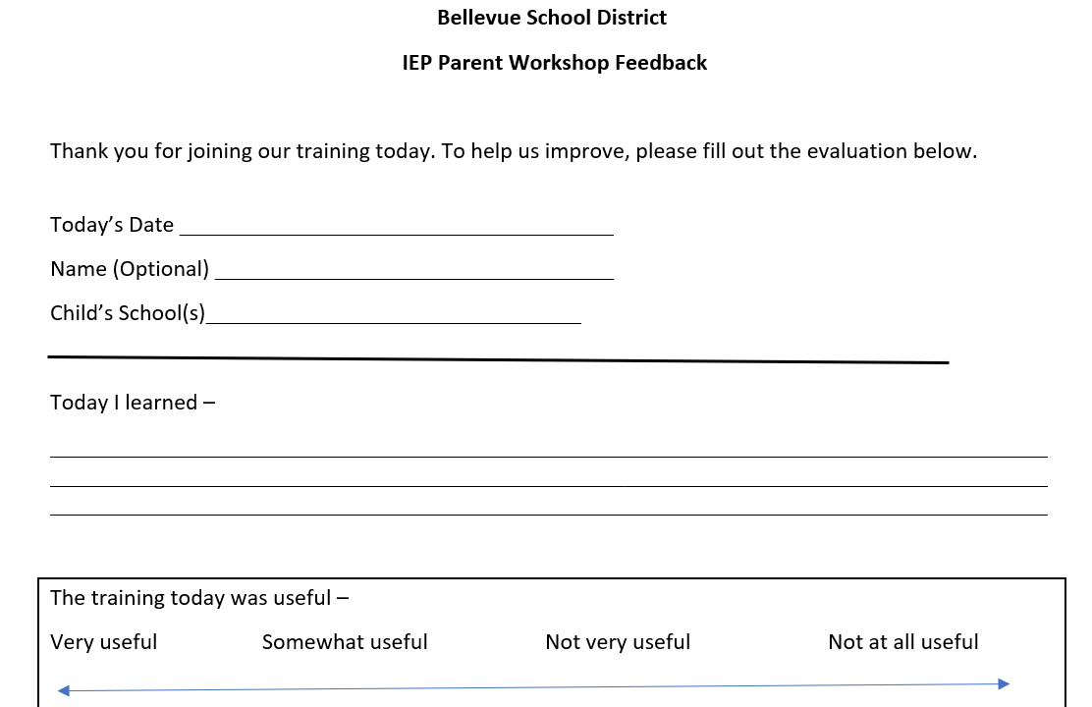
Workshop Feedback Form

Slide 40

Thank you for joining us!
Please pick up a small reminder that......
involved and supportive parents are lifesavers for their children!

