Slide 1
Tips and Tricks to Tackle Virtual Learning
Supporting Behavior and Organization Skills During Virtual Learning
Megan Kidder, BCBA and claire sherman, bcba
Notes:
Megan

Slide 2
Translation services are available through the Microsoft Translator app on your smart phone
Notes:
Megan

Slide 3
Questions
Time for questions at the end after recording has stopped
We are making generalized recommendations but cannot provide student-specific guidance. We recommend reaching out to your student's team for these types of questions
Longer questions can be addressed via email:
Megan: kidderme@bsd405.org
Claire: shermancl@bsd405.org
Notes:
Megan

Slide 4
What we will review
Part 1: Workspace set-up strategies
Part 2: Prompting strategies
Part 3: Preventative strategies
Part 4: Reward strategies
Notes:
Megan

Slide 5
Part 1: Workspace Strategies

Slide 6
Setting up your space (it doesn’t have to be complicated!)
When to use this:
Child has difficulty transitioning between leisure and academic activities.
Child is easily distracted, stares off into space, or tries to access leisure activities during class.
Child finds it difficult to sit still, or stay at the computer.
Child is sensitive to their environment, for example you notice they dislike a lot of noise.

Slide 7
Setting up your space (it doesn’t have to be complicated!)
Set aside specific space for learning and school work.
If you have an office or extra room: you can set this up as a school area.
If you have limited space in your home: use the environment to cue your child that it is time for learning.
Clear away clutter
Use items like the computer, pencils, and a notebook to signal they are at “school”

Slide 8
Setting up your space (it doesn’t have to be complicated!)
Before (messy table and TV)
After (Clear table, TV covered, materials out)

Slide 9
Support Focus, Minimize Distractions
Make sure the space surrounding your child is free from distractions.
Put toys away, turn the TV off, and provide a clean working space.
If multiple people are working at the same time, encourage headphones.

Slide 10
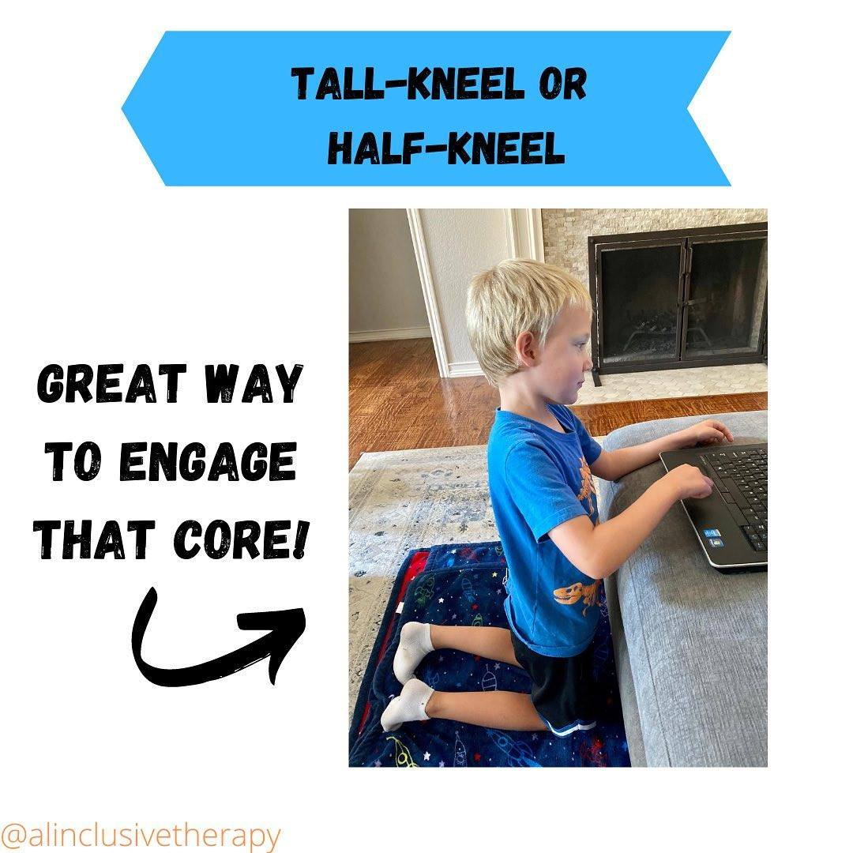
Provide Multiple Seating Options

Slide 11
Post a Schedule
Can help students get through challenging parts of the day.
Added structure can increase independence and decrease emotional meltdowns, and anxiety about the day.

Slide 12
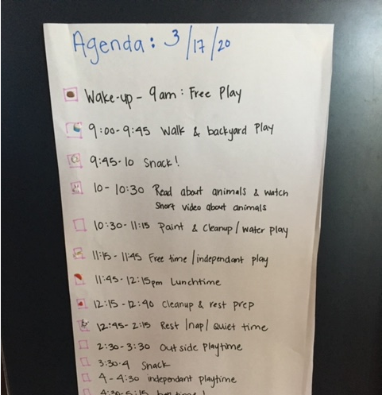
Post a schedule
Visual Schedule
Written Schedule
First-Then schedule

Slide 13
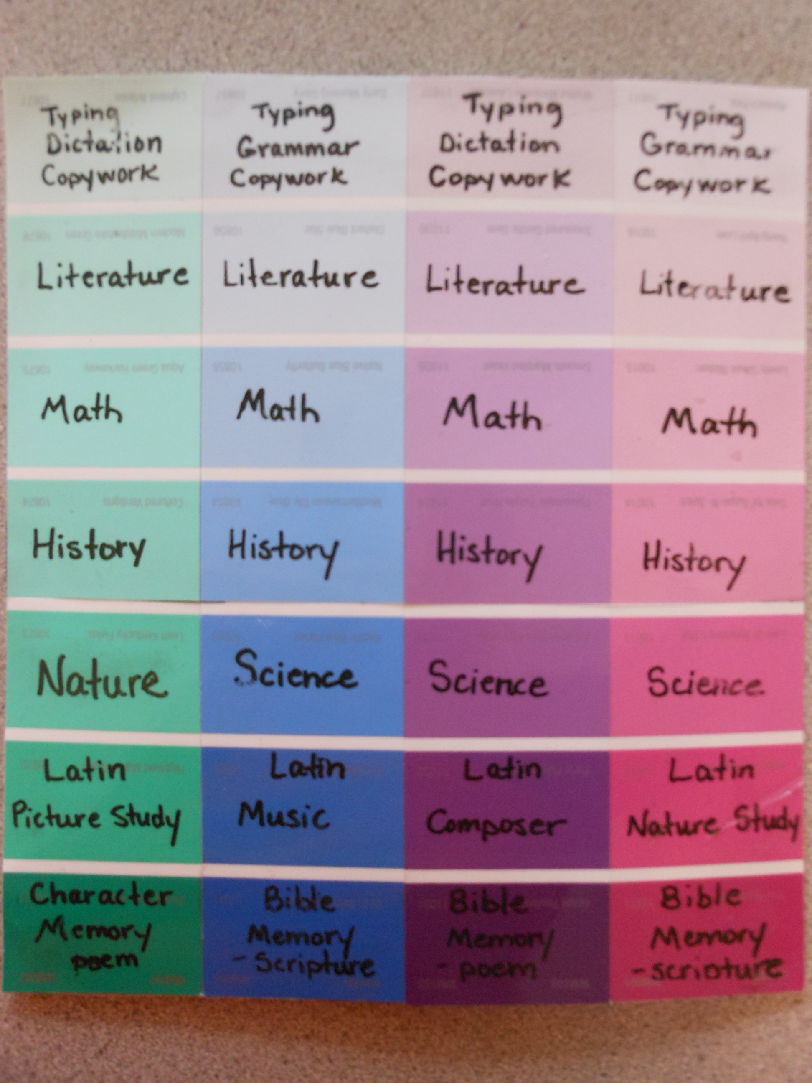
Post a Schedule

Slide 14
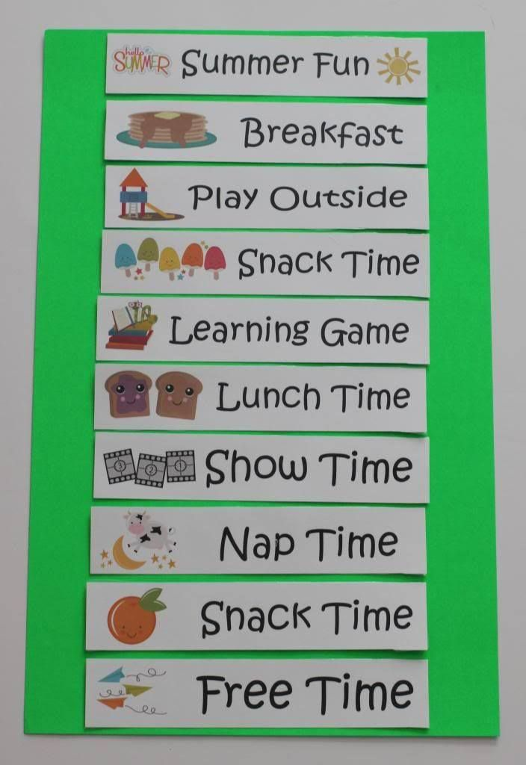
Post a Schedule

Slide 15
Post a Schedule

Slide 16
Part 2: Prompting Strategies

Slide 17
Prompting Strategies
When to use these:
An adult in the home is providing support and it is appropriate to consider reducing this support.
You want to increase student's independence with virtual learning.

Slide 18
Prompts
What is a prompt? Something added before or during a response to increase the likelihood of correct responding

Slide 19
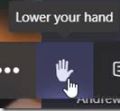
Example Scenario: Student is shouting out during virtual class. The classroom expectation is that students press the "raise hand" button on Teams
•Physical: Guide top of hand towards raise hand button
•Model: The “model” presses button then says, “your turn” and student imitates
•Verbal: Saying "click 'raise hand button'"
•Gestural: Point to raise hand button
•Visual: A sticker of an arrow is placed above button on the computer screen

Slide 20
Goal of prompts
Use to help reduce errors/increase correct responding, then “fade” them
Prompts are not meant to be permanent

Slide 21
Prompt Dependency
Think about what kind of prompt (if any) you are providing (is it verbal, is it physical, etc.?)
A subtle cue may be a prompt
Examples: Pointing to the screen, repeating the question
Avoid using the prompt for too long – doing this can lead to dependency on the prompt

Slide 22
Alternatives to adult prompts
Think about what natural cues could be used to support learning instead of adult prompts
Examples:
Using a watch or phone with a timer as a reminder to log in to class or transition to a different class
A checklist of steps accessible during the activity that requires increased assistance
A picture of the raise hand button taped to the computer
A Post-it with a written reminder to do something
A visual schedule or calendar with upcoming assignments/classes

Slide 23
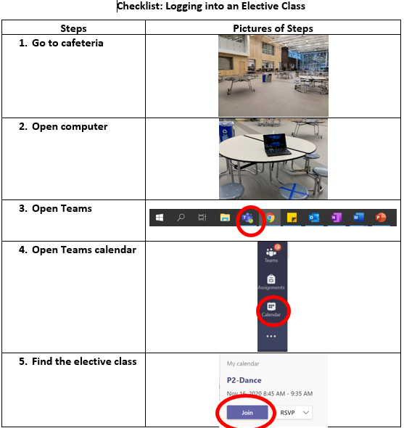
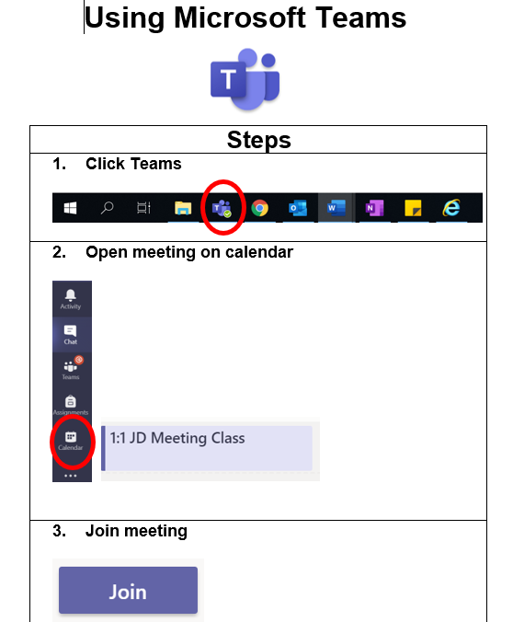
Example Checklists for Virtual Learning

Slide 24
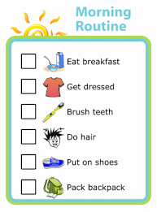
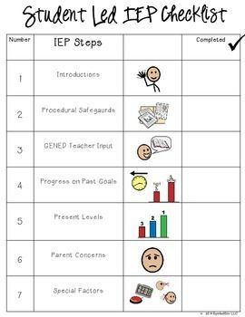
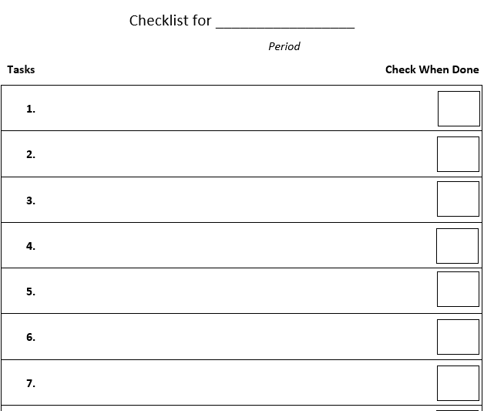
Other Checklist Examples

Slide 25
Additional Considerations
Set up the environment for success
For work that is intended to be completed by the student independently, try giving encouragement (“just do your best”) instead of answers
Know that mistakes are a part of the learning process

Slide 26
Part 3: Preventive Strategies

Slide 27
Preventing Challenging Behaviors… and Teaching New Ones!
When to Use this:
You notice repeated challenging behavior
You have a child who is impulsive, and has trouble controlling their behavior
You want to teach more independence, and help your child meet their academic goals.

Slide 28
Why Prevention?
Preventing behavior helps teach new behaviors
Gives kids more tools to get their needs met
Supports independence
Frees your time up – (less putting out fires, more of your day running smoothly)

Slide 29
Identify Goals for the Day
Put time in your schedule to review the daily expectations – I encourage you to do a daily morning check in!
Examples of expectations:
No Youtube
Stay on Teams
Complete assignments

Slide 30
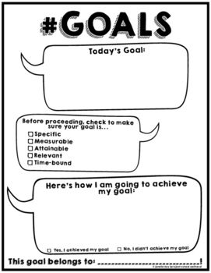
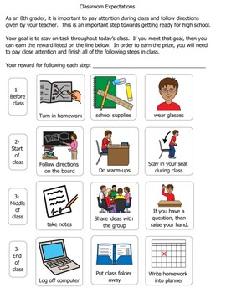
Identify Goals for the Day

Slide 31
Review Any New Strategies
For example:
How to ask for help from you, or the grownup available (i.e. flip a card that says “help please,” come get you, or wait until a designated time to ask for help).
What to do if they don’t understand something in their class or their assignment (i.e. ask a friend, ask a teacher)
What to do if they are having big feelings (use a sensory based strategy like jumping jacks, or sitting on a yoga ball, take a break).

Slide 32
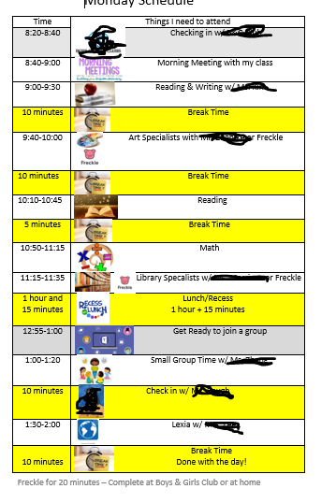
Use Your Schedule
Put breaks, snacks, and when they are finished on to the schedule!

Slide 33
Make Time for Fun
Plan at least 20 minutes of uninterrupted time to do a preferred activity with your child.

Slide 34
Part 4: Reward Strategies

Slide 35
Reward Strategies
When to use these:
Certain behaviors have been identified as important to increase.
You are using rewards but seeing little positive impact.

Slide 36
The Process
Pick behaviors that are important to INCREASE
01
Provide the reward after selected behavior occurs
04
Give your student a choice in what reward they are working for
03
Identify potential rewards
02
Monitor progress!
05

Slide 37
Identifying Behaviors for Increase Related to Virtual Learning
What behaviors will help your student succeed in class/school?
What behaviors might increase social interactions?
Examples:
Raising hand
Logging into class
Navigating the schedule
Maintaining safe hands
Completing an assignment
Muting microphone
Typing messages in the chat
Inviting a friend to study together (virtually)
So many more!

Slide 38
Identifying Potential Rewards
Identify high interest activities or items in the home that could be used as potential rewards to increase important behaviors
Ask your child
Observe your child
Present different items/activities and see what they pick
Examples include but are not limited to:

Slide 39
Be Specific
You want to be able to fade the tangible reward eventually. If you pair praise with the tangible, praise could become reinforcing over time
When giving verbal praise, make it specific. For example, instead of saying “good job”, saying “good job raising your hand”
+

Slide 40
Immediacy of reward
Deliver the reward immediately after the behavior is observed
Avoid placing additional demands after student meets criteria. You want to build an association between the behavior and the reward

Slide 41
Consistency
Keep these goals and rewards until you see consistent improvement
If you are not seeing improvement, think about:
Are the potential rewards appropriate?
Did I give a choice in what my student is working for?
Did I present the reward immediately after the target behavior?

Slide 42
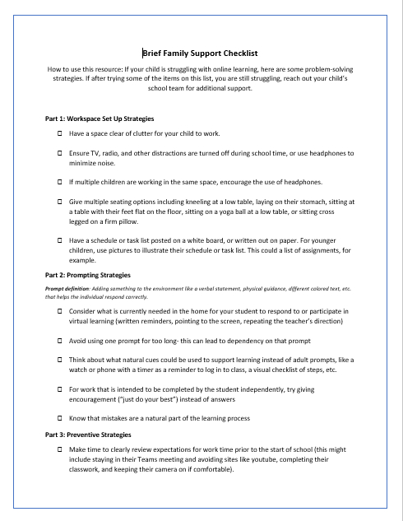
Checklist Summary

Slide 43
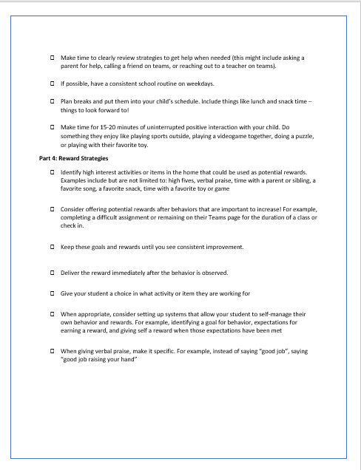
Checklist Summary

